Slide 1
Docker Introduction

Slide 2
Agenda
What is Docker
Container Vs Virtual Machine
Docker Platform Overview and Terminology
Docker Engine
Images
Containers
Registry
Repositories
Docker Hub
Docker Orchestration Tools
Intro to Images
Getting Started with containers

Slide 3
What is docker?
Docker is a platform for developing shipping and running applications using container virtualization technology.
Docker platform consists of multiple products/tools
Docker Engine
Docker Hub
Docker Machine
Docker Swarm
Docker Compose
Kitematic

Slide 4
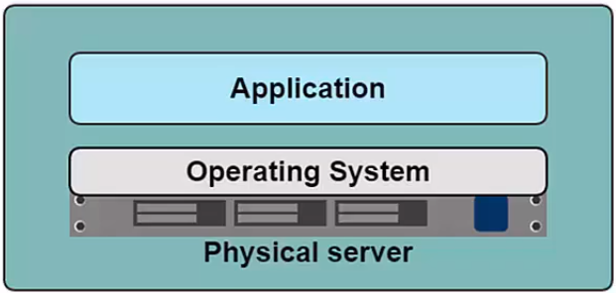
A history lesson
In the Dark Ages
One Application on one physical Server
Problems in the past
Slow Deployment Time
Huge Costs
Wasted Resources
Difficult to Scale
Difficult to migrate
Vendor lock in

Slide 5
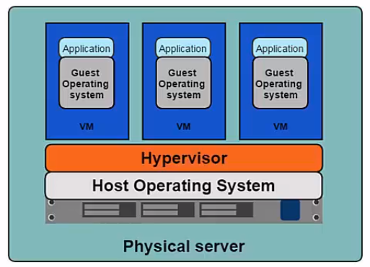
A hISTORY LESSON
Hyper-visor based Virtualization
One physical server can contain multiple applications
Each application runs in a Virtual Machine (VM)

Slide 6
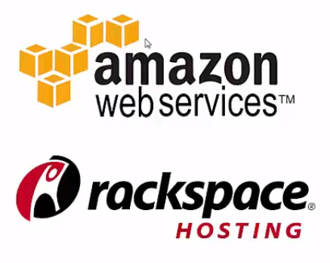
Benefits of vm
Better resource pooling
- One physical machine divided into multiple virtual machines
Easier to Scale
VMs in the Cloud
Rapid Elasticity
Pay as you go model

Slide 7
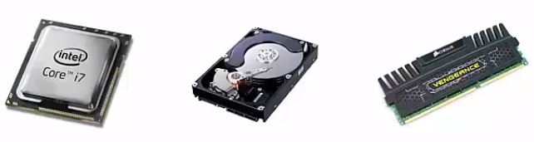
LIMITATIONS of VM
Each VM requires
CPU Allocation
Storage
RAM
An Entire Guest Operating System
The more VMs you run, the more resource you need
Guest OS means wasted resources
Application portability not guaranteed.

Slide 8
INTRODUCING CONTAINERS
Container based virtualization uses the kernel on the host’s operating system to run multiple guest instances
Each guest instance is called a container
Each container has its own
Root Filesystem
Process
Memory
Devices
Network Ports

Slide 9
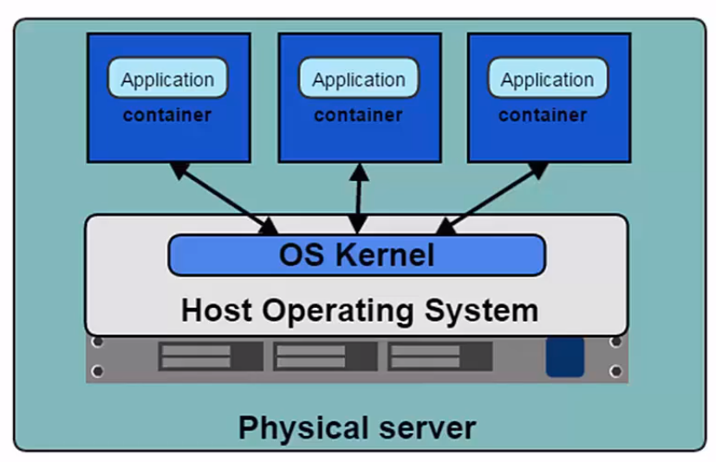
CONTAINERS

Slide 10
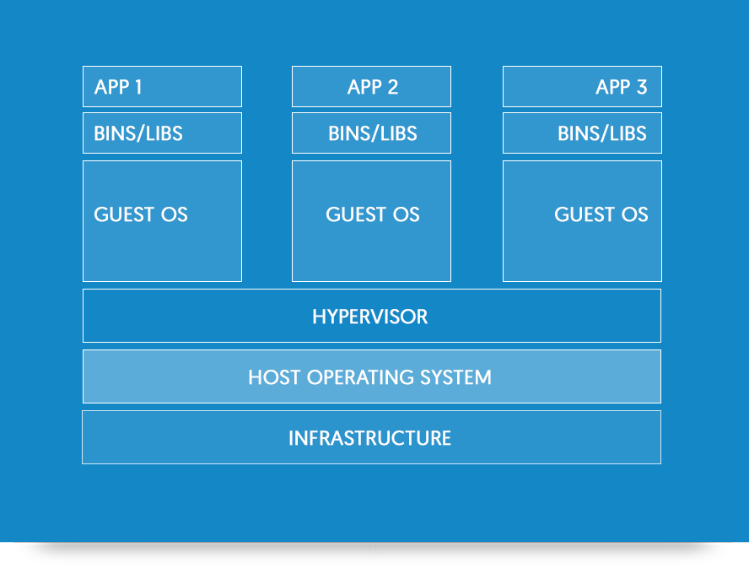
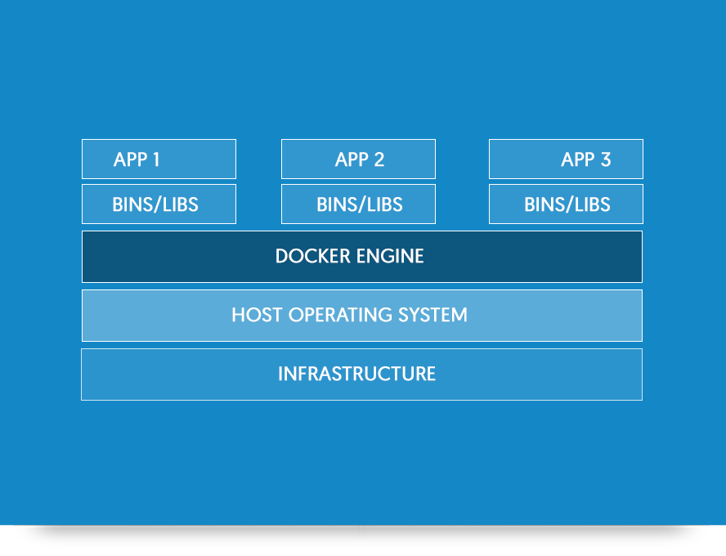
Containers vs vm
Containers are more lightweight.
No need to install guest os.
Less CPU,RAM and storage space required
More containers per machine than VMs.
Greater Portability.

Slide 11
DockER Concepts and Terms

Slide 12
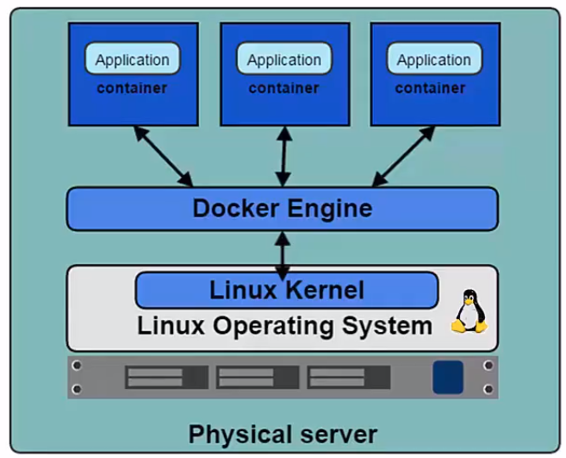
DOCKER And the linux kernel
Docker Engine is the program that enables containers to be build, shipped and run
Docker Engine uses Linux Kernel Namespaces and control groups
Namespaces gives us the isolated workspace

Slide 13



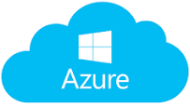
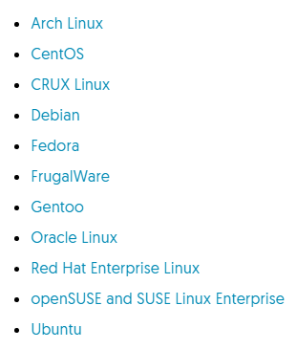

Platform support

Slide 14
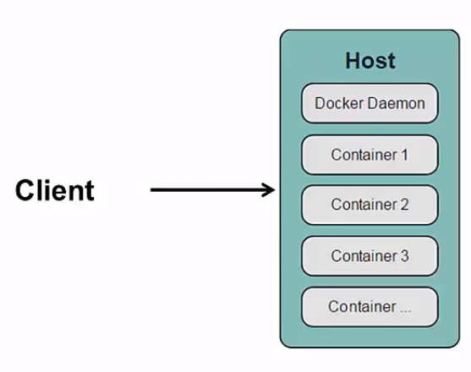
Docker client and daemon
Client/Server Architecture
Client takes user inputs & sends them to the daemon
Daemon builds, runs and distributes containers
Client and daemon can run on the same host or different hosts
CLI client and GUI (Kitematic)

Slide 15
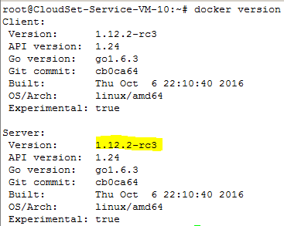
CHECKING CLIENT AND DAEMON Version
Run Command
docker version

Slide 16
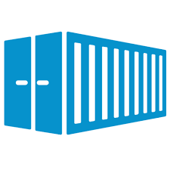
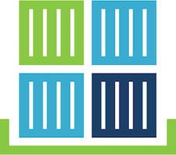
Docker containers and images
Images
Read only template used to create containers
Built by you or other docker users
Stored in Docker hub or your local registry
Containers
Isolated application platform
Contains everything needed to run your application
Based on one or more images
Containers
Created From
Image
Containers

Slide 17
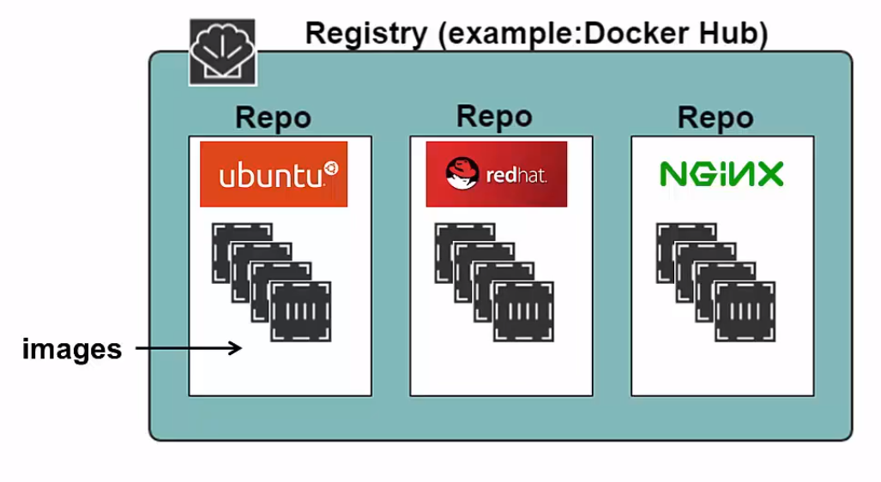
Registry & repository

Slide 18
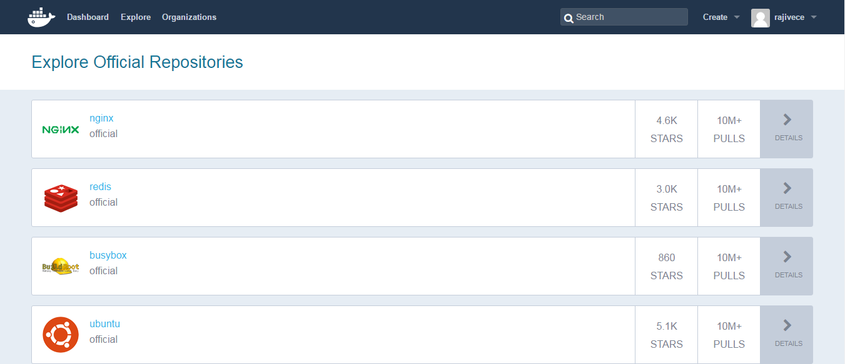
Docker hub
Docker Hub is a public registry that contains a large number of images available for your use

Slide 19
Docker orchestration
Three tools for orchestrating distributed applications with Docker
Docker Machine
Tool that provisions Docker hosts and installs Docker Engine on them
Docker Swarm
Tool that clusters many Engines and schedule containers
Docker Compose
Tool to create and mange multi-container applications

Slide 20
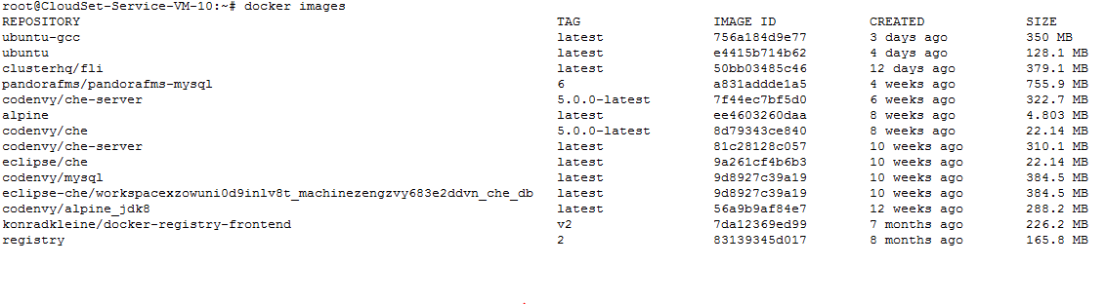
Display local images
Run
docker images

Slide 21
IMAGE TAGS
Images are specified by repository:tag
The same image may have multiple tags
The default tag is latest

Slide 22
Creating a container
Use docker run command
Run a simple container

Slide 23
Docker commands
attach Attach to a running container
build Build an image from a Dockerfile
commit Create a new image from a container's changes
cp Copy files/folders between a container and the local filesystem
create Create a new container
diff Inspect changes on a container's filesystem
events Get real time events from the server
exec Run a command in a running container
export Export a container's filesystem as a tar archive
history Show the history of an image
images List images
import Import the contents from a tarball to create a filesystem image
info Display system-wide information
inspect Return low-level information on a container or image
kill Kill a running container
load Load an image from a tar archive or STDIN
login Register or log in to a Docker registry
logout Log out from a Docker registry
logs Fetch the logs of a container
network Manage Docker networks
pause Pause all processes within a container
port List port mappings or a specific mapping for the CONTAINER
ps List containers
pull Pull an image or a repository from a registry
push Push an image or a repository to a registry
rename Rename a container
restart Restart a container
rm Remove one or more containers
rmi Remove one or more images
run Run a command in a new container

